Slide 1
Economic & Credit Union Update
If you have any questions or comments, please contact:
Steven Rick, Chief Economist
Trustage - Economics
800.356.2644, Ext. 665.5454
Steve.rick@TruStage.com
February 2026

Slide 2
3.0% Neutral Interest Rate
2% Inflation
1% Real Equilibrium
3.6%
Source: Federal Reserve

Slide 3
3.0% Neutral Interest Rate
2% Inflation
1% Real Equilibrium
3.6%
Accelerating the
Economy
Source: Federal Reserve

Slide 4
Fastest increase in
interest rates
in 40 years
(5.25)
3.0% Neutral Interest Rate
2% Inflation
1% Real Equilibrium
3.6%
Accelerating the
Economy
Source: Federal Reserve

Slide 5
July 2023
5.35%
Fastest increase in
interest rates
in 40 years
(5.25)
3.0% Neutral Interest Rate
2% Inflation
1% Real Equilibrium
3.6%
Accelerating the
Economy
Source: Federal Reserve

Slide 6
July 2023
5.35%
Fastest increase in
interest rates
in 40 years
(5.25)
3.0% Neutral Interest Rate
2% Inflation
1% Real Equilibrium
Braking the Economy
3.6%
Accelerating the
Economy
Source: Federal Reserve

Slide 7
July 2023
5.35%
Fastest increase in
interest rates
in 40 years
(5.25)
3.0% Neutral Interest Rate
2% Inflation
1% Real Equilibrium
Braking the Economy
3.6%
Stance of
Monetary Policy
Accelerating the
Economy
Source: Federal Reserve

Slide 8
July 2023
5.35%
Fastest increase in
interest rates
in 40 years
(5.25)
3.0% Neutral Interest Rate
2% Inflation
1% Real Equilibrium
Braking the Economy
2
1
Accelerating the
Economy
Source: Federal Reserve

Slide 9
July 2023
5.35%
Fastest increase in
interest rates
in 40 years
(5.25)
Braking the Economy
2
3.0% Neutral Interest Rate
1
Two Paths
Drop rates 0.50
(Focus on Labor Market)
Hold rates
(Focus on Inflation)
Accelerating the
Economy
Source: Federal Reserve

Slide 10
Long Run Average
5%
December
3.3%
Source: Federal Reserve

Slide 11
Weak Credit Union Loan Growth
19.1%
Long Run Average
7.0%
3.0%
Source: NCUA

Slide 12
Weak Credit Union Loan Growth
19.1%
Long Run Average
7.0%
Why Low Loan Growth?
High interest rates
High amortization of existing debt
Low consumer confidence
High uncertainty, Recession fears
3.0%
Source: NCUA

Slide 13
Jan. 2026
6.2%
Source: FDIC

Slide 14
Economic Growth Below Natural Growth Rate
2.0%

Slide 15
Economic Growth Below Natural Growth Rate
Fiscal stimulus
Lower interest rates
Credit deregulation
AI data center investment
2.0%

Slide 16
2.0%

Slide 17
Economic Growth Below Natural Growth Rate
Fiscal stimulus
Lower interest rates
Credit deregulation
AI data center investment
2.0%
Economic Risks:

Slide 18
Economic Growth Below Natural Growth Rate
Fiscal stimulus
Lower interest rates
Credit deregulation
AI data center investment
2.0%
Economic Risks:
Worsening Trade War

Slide 19
Economic Growth Below Natural Growth Rate
Fiscal stimulus
Lower interest rates
Credit deregulation
AI data center investment
2.0%
Economic Risks:
Worsening Trade War
Federal Reserve too slow in lowering interest rates

Slide 20
Economic Growth Below Natural Growth Rate
Fiscal stimulus
Lower interest rates
Credit deregulation
AI data center investment
2.0%
Economic Risks:
Worsening Trade War
Federal Reserve too slow in lowering interest rates
Decrease in stock & home prices

Slide 21
Home Price Appreciation are below Long Run Levels
10.7%
4.1%
2.9%
Q2 2025
Seasonally-Adjusted Purchase-Only Index
-10.0%
Source: OFHEO

Slide 22
Rising Stock Prices Producing Positive “Wealth Effect”
among High-Income Households
Shiller PE Ratio
Price earnings ratio is based on average inflation-adjusted earnings from the previous 10 years.
Cyclically Adjusted PE Ratio
(CAPE Ratio)
6,880
Source: S&P Dow Jones Indices

Slide 23
Rising Stock Prices Producing Positive “Wealth Effect”
among High-Income Households
Shiller PE Ratio
Price earnings ratio is based on average inflation-adjusted earnings from the previous 10 years.
Cyclically Adjusted PE Ratio
(CAPE Ratio)
6,880
Source: S&P Dow Jones Indices

Slide 24
Real S&P 500 Stock Index average
Rising Stock Prices Producing Positive “Wealth Effect”
among High-Income Households
Shiller PE Ratio
Price earnings ratio is based on average inflation-adjusted earnings from the previous 10 years.
Cyclically Adjusted PE Ratio
(CAPE Ratio)
6,880
20-Year Average
Quantity of Good/Services
2,000
Source: S&P Dow Jones Indices

Slide 25
244% Rise in S&P 500 Stock Index
Rising Stock Prices Producing Positive “Wealth Effect”
among High-Income Households
Shiller PE Ratio
Price earnings ratio is based on average inflation-adjusted earnings from the previous 10 years.
Cyclically Adjusted PE Ratio
(CAPE Ratio)
6,880
244% Rise in 10 Years
20-Year Average
Quantity of Good/Services
2,000
Source: S&P Dow Jones Indices

Slide 26
Rising Stock Prices Producing Positive “Wealth Effect”
among High-Income Households
Shiller PE Ratio
Price earnings ratio is based on average inflation-adjusted earnings from the previous 10 years.
Cyclically Adjusted PE Ratio
(CAPE Ratio)
6,880
50-10 Rule
Source: S&P Dow Jones Indices

Slide 27
Rising Stock Prices Producing Positive “Wealth Effect”
among High-Income Households
Shiller PE Ratio
Price earnings ratio is based on average inflation-adjusted earnings from the previous 10 years.
Cyclically Adjusted PE Ratio
(CAPE Ratio)
6,880
50-10 Rule
Is this 1929 Again?
Source: S&P Dow Jones Indices

Slide 28
Rising Stock Prices Producing Positive “Wealth Effect”
among High-Income Households
Shiller PE Ratio
Price earnings ratio is based on average inflation-adjusted earnings from the previous 10 years.
Cyclically Adjusted PE Ratio
(CAPE Ratio)
6,880
Source: S&P Dow Jones Indices

Slide 29
Rising Stock Prices Producing Positive “Wealth Effect”
among High-Income Households
Shiller PE Ratio
Price earnings ratio is based on average inflation-adjusted earnings from the previous 10 years.
Cyclically Adjusted PE Ratio
(CAPE Ratio)
6,880
27 = Long Run Average
Source: S&P Dow Jones Indices

Slide 30
Rising Stock Prices Producing Positive “Wealth Effect”
among High-Income Households
Shiller PE Ratio
Price earnings ratio is based on average inflation-adjusted earnings from the previous 10 years.
Cyclically Adjusted PE Ratio
(CAPE Ratio)
6,880
44
27 = Long Run Average
Source: S&P Dow Jones Indices

Slide 31
Rising Stock Prices Producing Positive “Wealth Effect”
among High-Income Households
Shiller PE Ratio
Price earnings ratio is based on average inflation-adjusted earnings from the previous 10 years.
Cyclically Adjusted PE Ratio
(CAPE Ratio)
6,880
44
38
27 = Long Run Average
Source: S&P Dow Jones Indices

Slide 32
Rising Stock Prices Producing Positive “Wealth Effect”
among High-Income Households
Shiller PE Ratio
Price earnings ratio is based on average inflation-adjusted earnings from the previous 10 years.
Cyclically Adjusted PE Ratio
(CAPE Ratio)
6,880
44
41
38
27 = Long Run Average
Source: S&P Dow Jones Indices

Slide 33
Rising Stock Prices Producing Positive “Wealth Effect”
among High-Income Households
Shiller PE Ratio
Price earnings ratio is based on average inflation-adjusted earnings from the previous 10 years.
Cyclically Adjusted PE Ratio
(CAPE Ratio)
6,880
Will AI => ↑ productivity => ↓ expenses => ↑ earnings => ↓ P/E Ratio?
44
41
38
27 = Long Run Average
Source: S&P Dow Jones Indices

Slide 34
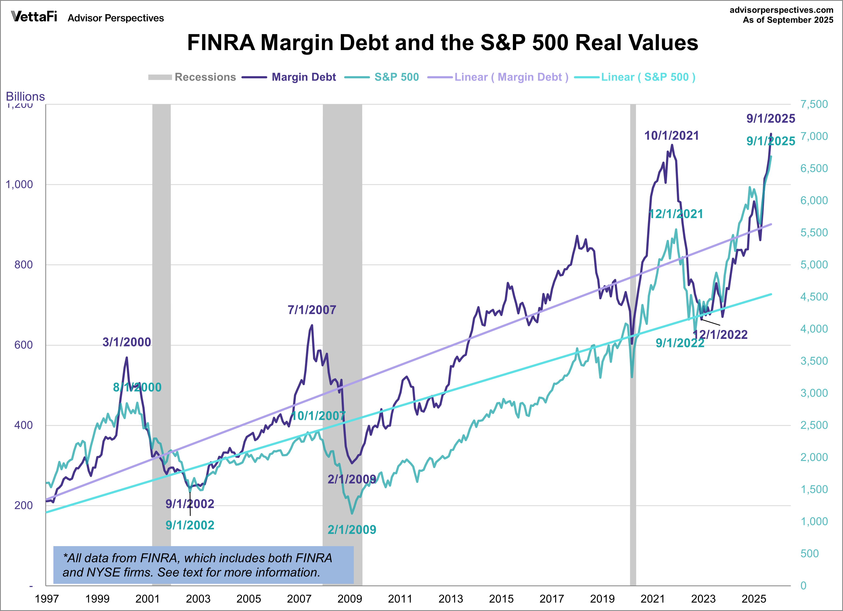
Margin Debt = $1.1 trillion
39% year-over-year

Slide 35
Economic Growth Below Natural Growth Rate
Fiscal stimulus
Lower interest rates
AI data center investment
2.0%
Economic Risks:
Worsening Trade War
Federal Reserve too slow in lowering interest rates
Decrease in stock & home prices
Russia/Ukraine war & Israel/Iran war

Slide 36
Economic Growth Below Natural Growth Rate
Fiscal stimulus
Lower interest rates
Credit deregulation
AI data center investment
2.0%
Economic Risks:
Worsening Trade War
Federal Reserve too slow in lowering interest rates
Decrease in stock & home prices
Russia/Ukraine war & Israel/Iran war
Rise in energy prices

Slide 37
Economic Growth Below Natural Growth Rate
Fiscal stimulus
Lower interest rates
Credit deregulation
AI data center investment
2.0%
Economic Risks:
Worsening Trade War
Federal Reserve too slow in lowering interest rates
Decrease in stock & home prices
Russia/Ukraine war & Israel/Iran war
Rise in energy prices
Lower-quality office property: ↓ occupancy, ↓ rent, ↓ pricing => ↓ refinancing

Slide 38
Sales Forecast
2024: 15.8 million
2025: 16.1 million (2.0%)
2026: 16.0 million (-0.5%)

Slide 39
5.0%
Long Run
Average

Slide 40
7.7%
Long Run
Average

Slide 41
Vehicle Prices are Rising
2.0% Target
0.3%
Source: Bureau of Labor Statistics

Slide 42
Vehicle Prices are Rising
2.0% Target
5.1%
0.7%

Slide 43
Vehicle Prices are Rising
2.0% Target
5.1%
0.7%
Increase loan charge-offs
Decrease trade-in values

Slide 44
Source: Bureau of Labor Statistics

Slide 45
0.94%
Source: Bureau of Labor Statistics

Slide 46
0.94%
0.75%
Natural Delinquency Rate
Source: Bureau of Labor Statistics

Slide 47
130,000
20,000
Source: Bureau of Labor Statistics

Slide 48
Millions

Slide 49
Thousands
Service Providing
417,000 Jobs

Slide 50
Wage Growth Slowing as Core Inflation Falls
3.7%
Source: Bureau of Labor Statistics

Slide 51
Wage Growth Slowing as Core Inflation Falls
3.7%
2.5%
Core Inflation
Source: Bureau of Labor Statistics

Slide 52
Wage Growth Slowing as Core Inflation Falls
3.7%
2.5%
Core Inflation
Source: Bureau of Labor Statistics

Slide 53
Wage Growth Slowing as Core Inflation Falls
3.7%
2.5%
2024-2025
Rising Real Wages
Core Inflation
Source: Bureau of Labor Statistics

Slide 54
6,542
Source: Bureau of Labor Statistics

Slide 55
6,542
5,293
Source: Bureau of Labor Statistics

Slide 56
6,542
5,293
3,204
Source: Bureau of Labor Statistics

Slide 57
4.2%

Slide 58
0.75%
4.2%

Slide 59
0.75%
4.2%
0.50%
Natural Charge-off Rate

Slide 60
Falling real wages (inflation > wage growth)
0.75%
4.2%
0.50%
Natural Charge-off Rate

Slide 61
Falling real wages (inflation > wage growth)
High rent inflation => tight budgets
0.75%
4.2%
0.50%
Natural Charge-off Rate

Slide 62
Falling real wages (inflation > wage growth)
High rent inflation => tight budgets
Student loan payment resumption
0.75%
4.2%
0.50%
Natural Charge-off Rate

Slide 63
Falling real wages (inflation > wage growth)
High rent inflation => tight budgets
Student loan payment resumption
Higher interest rates on credit card, HELOC, ARMs
0.75%
4.2%
0.50%
Natural Charge-off Rate

Slide 64
Falling real wages (inflation > wage growth)
High rent inflation => tight budgets
Student loan payment resumption
Higher interest rates on credit card, HELOC, ARMs
Slow loan growth => denominator effect
0.75%
4.2%
0.50%
Natural Charge-off Rate

Slide 65
Falling real wages (inflation > wage growth)
High rent inflation => tight budgets
Student loan payment resumption
Higher interest rates on credit card, HELOC, ARMs
Slow loan growth => denominator effect
High car insurance costs => drop collision coverage
0.75%
4.2%
0.50%
Natural Charge-off Rate

Slide 66
Falling real wages (inflation > wage growth)
High rent inflation => tight budgets
Student loan payment resumption
Higher interest rates on credit card, HELOC, ARMs
Slow loan growth => denominator effect
High car insurance costs => drop collision coverage
Walk Away Auto Repos
0.75%
4.2%
0.50%
Natural Charge-off Rate

Slide 67
Inflation Above 2% Target
2.0% Target
Source: Bureau of Labor Statistics

Slide 68
Inflation Above 2% Target
2.8% average last 23 months
2.0% Target
Dec.
2025
2.8%
Source: Bureau of Labor Statistics

Slide 69
Inflation Above 2% Target
Pass Through Tariffs
Zero immigration => tight labor supply
2.0% Target
Source: Bureau of Labor Statistics

Slide 70
Inflation Above 2% Target
Pass Through Tariffs
Zero immigration => tight labor supply
2.0% Target
Productivity enhancing AI
Falling shelter costs
Source: Bureau of Labor Statistics

Slide 71
Inflation Above 2% Target
2.0% Target
Inflation Takeaways:
↑ HH financial stress
↑ loan delinquency rates
↑ Interest rates
↑ Labor costs
↑ Operating expenses
Lower consumer confidence
Source: Bureau of Labor Statistics

Slide 72
July 2023
5.35%
Fastest increase in
interest rates
in 40 years
(5.25)
3.0% Neutral Interest Rate
2% Inflation
1% Real Equilibrium
Braking the Economy
2
1
Two Paths
Drop rates 0.50
(Focus on Labor Market)
Hold rates
(Focus on Inflation)
Accelerating the
Economy
Source: Federal Reserve

Slide 73
Credit Union
Balance Sheet

Slide 74
Credit Union
Balance Sheet
Assets

Slide 75
Credit Union
Balance Sheet
Assets
Liabilities + Capital

Slide 76
Credit Union
Balance Sheet
Assets
Liabilities + Capital
Deposits
Checking Accounts
Savings
Money Market Deposits
Certificates of Deposits

Slide 77
Stronger Credit Union Savings Growth
7 %
long run
average

Slide 78
6%
Long Run
Average
3.7%
Savings Rate
Source: Bureau of Economic Analysis

Slide 79
6%
Long Run
Average
3.7%
Savings Rate
Source: Bureau of Economic Analysis

Slide 80
Short Run: Boost spending and economy
Long Run: Increase financial stress in recession
6%
Long Run
Average
3.7%
Savings Rate
Source: Bureau of Economic Analysis

Slide 81
Credit Union
Balance Sheet
Assets
Liabilities + Capital
Cash (Reserves)
Deposits
Checking Accounts
Savings
Money Market Deposits
Certificates of Deposits
Investments
< 1 year maturity 50%
1–3 year maturity 19%
> 3-year maturity 31%

Slide 82
Investments Are Low but Yields Are Rising
36.5%
32%
Long Run
Average
25.7%

Slide 83
Credit Union
Balance Sheet
Assets
Liabilities + Capital
Cash (Reserves)
Deposits
Checking Accounts
Savings
Money Market Deposits
Certificates of Deposits
Investments
< 1 year maturity
1–3-year maturity
> 3-year maturity
Loans
Commercial
Auto
Home
Credit Card

Slide 84
Slow Credit Union Loan Growth

Slide 85
Credit Union
Balance Sheet
Assets
Liabilities + Capital
Cash (Reserves)
Deposits
Checking Accounts
Savings
Money Market Deposits
Certificates of Deposits
Fixed Assets
Land
Building
Equipment
Borrowings
Federal Home Loan Bank
Corporate Line of Credit
Fed Funds Purchased
Bank Term Funding Program
Investments
< 1 year maturity
1–3-year maturity
> 3-year maturity
Loans
Commercial
Auto
Home
Credit Card
Equity (Net Capital)
Undivided Earnings
Regular Reserves
Gains (losses) on Available For Sale (AFS) Securities

Slide 86
Credit Union
Balance Sheet
Assets
Liabilities + Capital
Cash (Reserves)
Deposits
Checking Accounts
Savings
Money Market Deposits
Certificates of Deposits
Fixed Assets
Land
Building
Equipment
Borrowings
Federal Home Loan Bank
Corporate Line of Credit
Fed Funds Purchased
Bank Term Funding Program
Investments
< 1 year maturity
1–3-year maturity
> 3-year maturity
Loans
Commercial
Auto
Home
Credit Card
Equity (Net Capital)
Undivided Earnings
Regular Reserves
Gains (losses) on Available For Sale (AFS) Securities
Allowance for Loan Loss

Slide 88
COVID Pandemic

Slide 89
Current Expected Credit Loss Model CECL
COVID Pandemic

Slide 90
78 basis points
long run
average

Slide 91
78 basis points
long run
average
2026
Rising Net Interest Margins
Falling Operating Expense ratios

Slide 92
Economic Update Summary For 2026

Slide 93
Economic Update Summary For 2026
Above trend economic growth in 2026, (2.4%)

Slide 94
Economic Update Summary For 2026
Above trend economic growth in 2026, (2.4%)
Inflation remaining above target during the next 2 years

Slide 95
Economic Update Summary For 2026
Above trend economic growth in 2026, (2.4%)
Inflation remaining above target during the next 2 years
Unemployment rate rising to natural rate of 4.5% in 2026

Slide 96
Economic Update Summary For 2026
Above trend economic growth in 2026, (2.4%)
Inflation remaining above target during the next 2 years
Unemployment rate rising to natural rate of 4.5% in 2026
Short-term interest rates falling 50 bp in 2026

Slide 97
Economic Update Summary For 2026
Above trend economic growth in 2026, (2.4%)
Inflation remaining above target during the next 2 years
Unemployment rate rising to natural rate of 4.5% in 2026
Short-term interest rates falling 50 bp in 2026
Credit union loan growth below trend in 2026, (5.5%)

Slide 98
Economic Update Summary For 2026
Above trend economic growth in 2026, (2.4%)
Inflation remaining above target during the next 2 years
Unemployment rate rising to natural rate of 4.5% in 2026
Short-term interest rates falling 50 bp in 2026
Credit union loan growth below trend in 2026, (5.5%)
Credit Union Return on Assets expected to rise to 0.80% in 2026

Slide 99
Credit unions are so robust that,…..

Slide 100
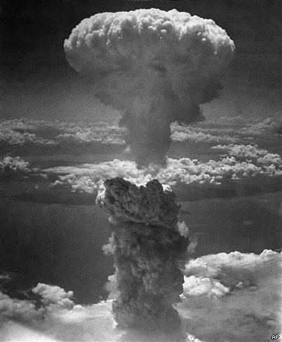
Credit unions are so robust that,…..

Slide 101

Credit unions are so robust that,…..

Slide 102
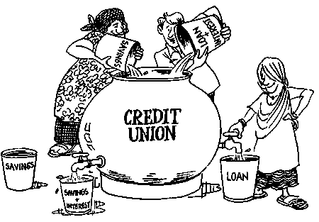
Credit unions are so robust that,…..

Slide 103

Credit unions are so robust that,…..

Slide 104
Carpe Diem
“Seize the day”

Slide 105
Questions?

Slide 107
The End

Slide 108
Economic Forecast January 2026
 | Past results |  | Quarterly Actual/Forecasts |  |  |  | Annual Forecasts
 | Previous 10 Yr. Avg | 2025 | 2026 Q1 | 2026 Q2 | 2026 Q3 | 2026 Q4 | 2026 | 2027
Growth rates:
Economic Growth (% chg GDP)* | 2.5% | 2.8% | 2.2% | 2.0% | 2.0% | 1.5% | 2.2% | 2.4%
Inflation (CPI, 12 mth % chg) | 3.3% | 2.7% | 2.7% | 2.7% | 2.6% | 2.5% | 2.5% | 2.3%
Unemployment Rate (BLS) | 4.3% | 4.4% | 4.5% | 4.6% | 4.6% | 4.6% | 4.6% | 4.6%
Federal Funds Rate (effective) | 2.36% | 3.64% | 3.60% | 3.60% | 3.40% | 3.40% | 3.40% | 3.10%
10-Year Treasury Rate | 2.84% | 4.18% | 4.20% | 4.30% | 4.20% | 4.20% | 4.20% | 4.20%
10-Year-Fed Funds Spread | 0.48% | 0.54% | 0.60% | 0.70% | 0.80% | 0.80% | 0.80% | 1.10%
*Percent change, annualized rate for quarterly and Q4-to-Q4 change for annual. All other numbers are end-of-period values.

Slide 109
Credit Union Forecast January 2026
 | Past Results |  | Forecasts |  |  |  | Annual Forecasts
 | 10 Yr Average | 2025 | 2026 Q1 | 2026 Q2 | 2025 Q3 | 2025 Q4 | 2026 | 2027
Growth rates:
Savings growth | 7.4% | 5.0% | 4.0% | 0.4% | 0.4% | 1.2% | 6.0% | 6.5%
Loan growth | 8.1% | 4.5% | 0.6% | 2.1% | 1.8% | 1.0% | 5.5% | 6.5%
Asset growth | 7.3% | 5.0% | 2.8% | 0.7% | 0.7% | 1.3% | 5.5% | 6.0%
Membership growth | 3.5% | 2.5% | 0.5% | 1.0% | 0.5% | 0.5% | 2.5% | 3.0%
Liquidity:
Loan-to-share ratio** | 81.15% | 83.6% | 80.9% | 82.2% | 83.4% | 83.2% | 83.2% | 83.2%
Asset quality:
Delinquency rate** | 0.75% | 0.95% | 0.82% | 0.83% | 0.85% | 0.85% | 0.85% | 0.80%
Net charge-off rate* | 0.55% | 0.80% | 0.75% | 0.72% | 0.70% | 0.77% | 0.75% | 0.65%
Earnings:
Return on average assets (ROA)* | 0.67% | 0.70% | 0.80% | 0.85% | 0.85% | 0.75% | 0.80% | 0.85%
Capital adequacy:
Net worth ratio** | 10.9% | 11.3% | 11.2% | 11.3% | 11.4% | 11.4% | 11.4% | 11.4%
*Quarterly data, annualized. **End of period ratio. Net worth forecast does not account for CECL Provision

Slide 110
Stablecoin Issuer Business Model Balance Sheet View
Stablecoin Issuer Balance Sheet
Assets
Liabilities + Capital
Investments
US Treasury Bills
Money Market Funds
Cash
Stablecoins Issued
Digital Tokens Redeemable 1:1 for USD
The primary liability for issuers are the stablecoins themselves.
The bulk of issuers’ assets are high-quality, liquid investments (Treasury bills, money market funds).
Operating Liabilities
Accounts Payables
Accrued Expenses
Other Assets
Technology and Equipment
Working Capital
Intellectual Property, etc.
Equity (Capital Buffer)

Slide 111
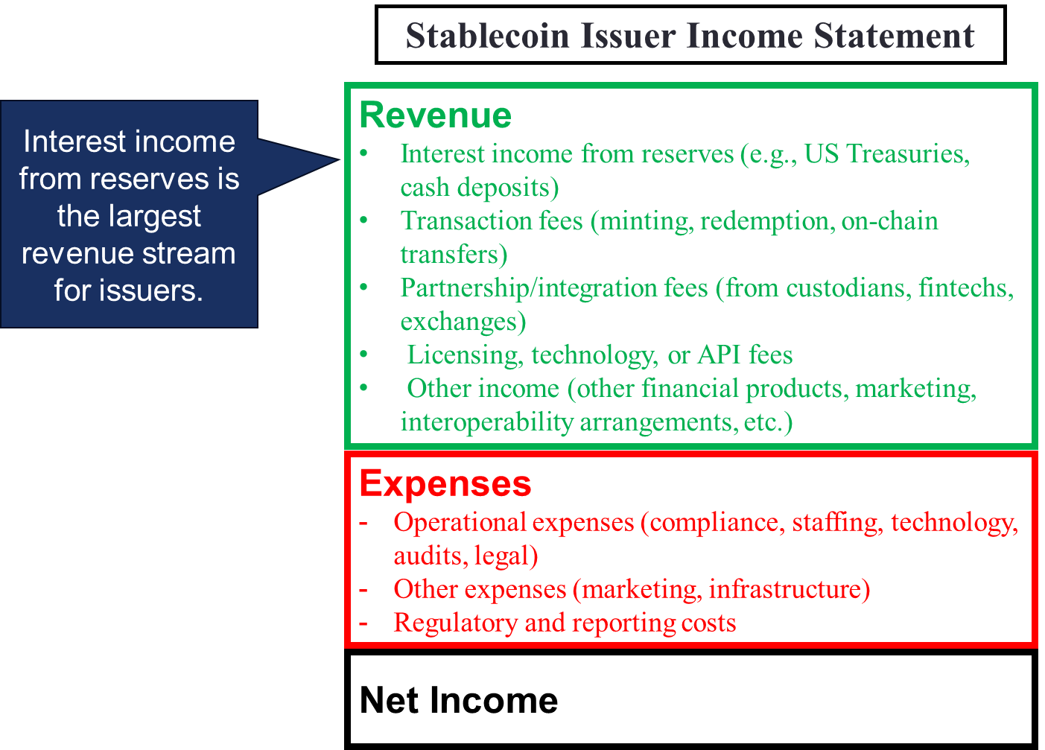
Stablecoin Issuer Business Model Income Statement View

Slide 112
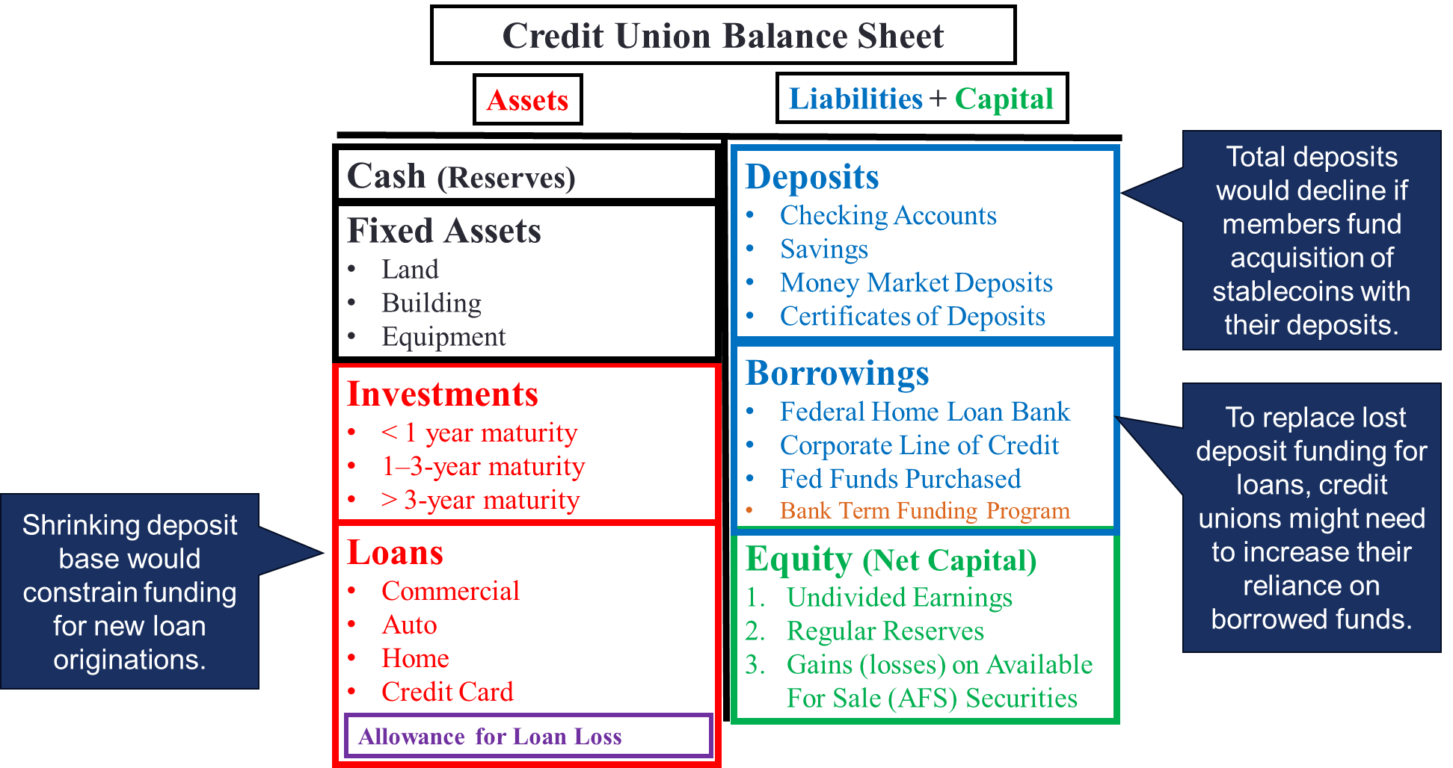
Implications for CU Balance Sheets
Note: The GENIUS Act prohibits NCUA from requiring a credit union to record stablecoins held in custody on its balance sheet as a liability. Instead, they are to be treated as assets held in custody for clients, so they are off-balance sheet. As a result, they are not treated as a balance sheet risk, which would otherwise require the credit union to hold additional regulatory capital against them.

Slide 113
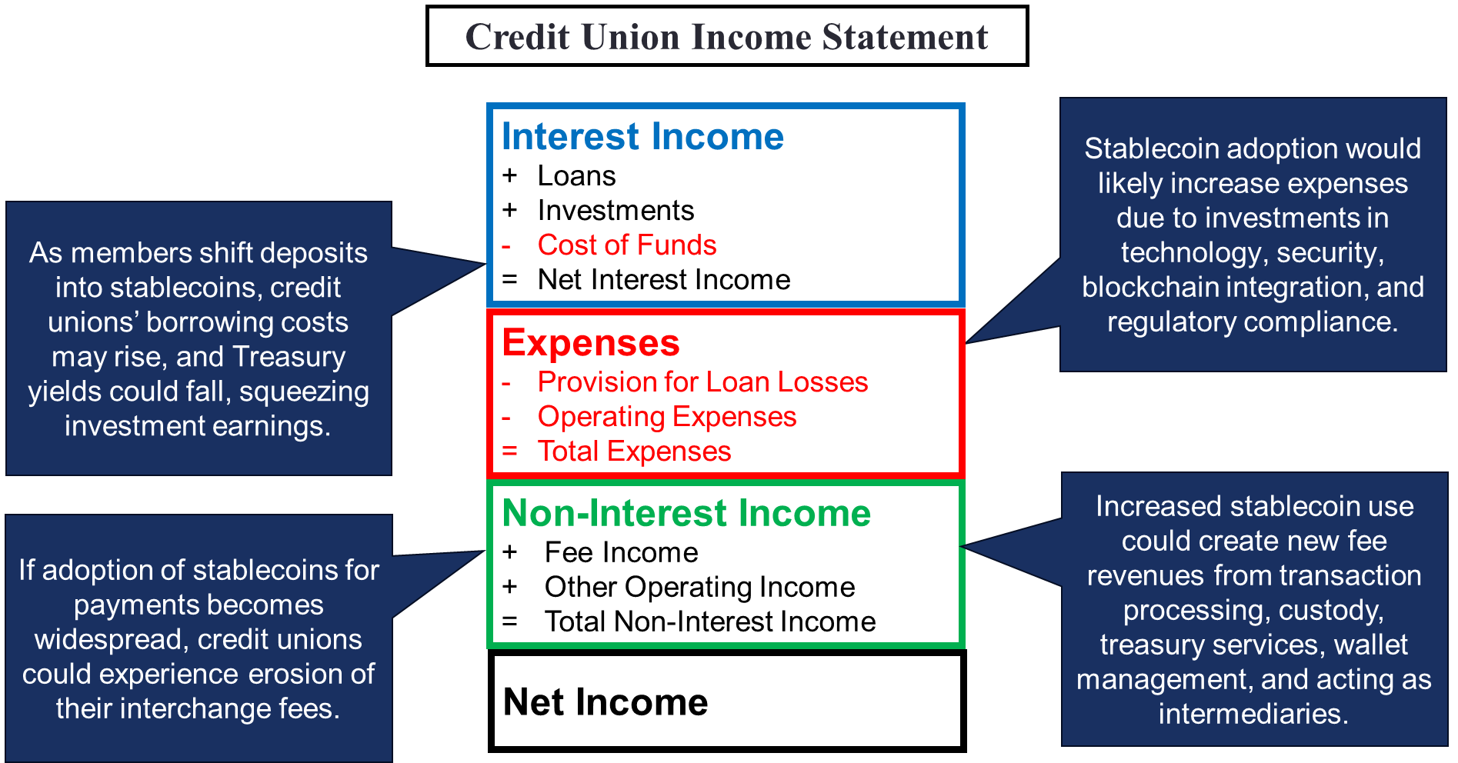
Implications for CU Income Statements

